Slide 1

G3T7
FINAL PRESENTATION
Cliffen, Wen Rui, Xian Shuang, Yi Fan

Slide 2

SCHEDULE

Slide 3
ITER 1 & 2

Slide 4
ITER 3 & 4

Slide 5

FUNCTIONALITIES
ADDED
DROPPED
FRAMEWORKS
Display student's current timetable
Search for courses via course name
Provide admin with results of current bids placed by students
NONE
NONE

Slide 6

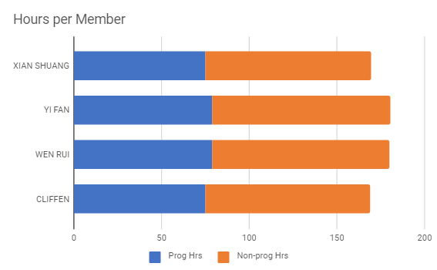
BREAKDOWN

Slide 7
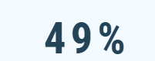
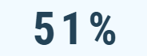
BREAKDOWN
PROGRAMMING TASKS
PAIRED PROGRAMMERS | TASK | HOURS
CLIFFEN & XIAN SHUANG | Add bid Delete bid Drop section Round 1 clearing logic Round 2 clearing logic Debug UAT Bid status | 75
WEN RUI + YI FAN | Admin & User page Bootstrap Authenticate Start & Stop Dump Admin search functions UI | 79

Slide 8
BREAKDOWN
NON-PROGRAMMING TASKS
ITERATION | PM | MINUTES | TESTING
1 | CLIFFEN | XIAN SHUANG | EVERYONE
2 | YI FAN | WEN RUI | EVERYONE
3 | XIAN SHUANG | CLIFFEN | EVERYONE
4 | WEN RUI | YI FAN | EVERYONE
5 | CLIFFEN | - | -

Slide 9

PROBLEMS FACED TRACKING SCHEDULE
ISSUE
SOLUTION
Difficult to determine time required for certain task beforehand
Plan for additional buffer time, constantly organize planning and meetings to reschedule

Slide 10
BUG METRICS

Slide 11

METRIC VALUES
Iteration 1 | Iteration 2 | Iteration 3 | Iteration 4
26 | 58 | 66 | 82

Slide 12
USE OF METRICS TO FIX PROBLEMS IDENTIFIED
Severity | Description
Low Impact (1 points) | Unimportant. Typo error or small user interface alignment issues.
High Impact (5 points) | The system runs. However, some non-critical functionalities are not working.
Critical Impact(10 points) | The system is down or is un-usable after a short period of time. We have to fix the bugs to continue.
Points in Iteration | Action
Points < 10 | Use the planned debugging time in the iteration.
Points >= 10 | Stop current development and resolve the bug immediately. Project Manager reschedules the project.

Slide 13



SEVERE PROBLEMS IDENTIFIED BY METRICS
Update bid function
SQL CONSTRAINTS
Errors in the coding of update bid function caused a chain effect of problems faced by students placing bids and viewing bid status
Round clearing unable to proceed due to sql constraints

Slide 14
CHALLENGES FACED USING METRICS
Difficult to gauge severity of bugs as it is subjective to each tester
ACTIONS TAKEN TO OVERCOME THEM:
Set up examples for all members to follow when determining the severity of the bugs
Discuss as a team to determine the severity of the bugs

Slide 15
USE OF GIT

Slide 16

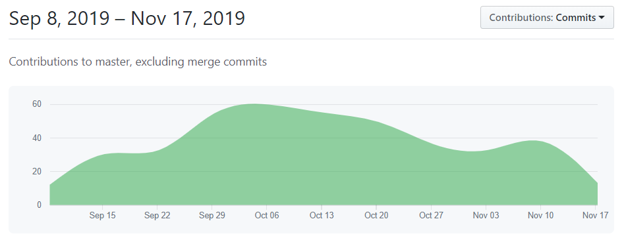

Slide 17
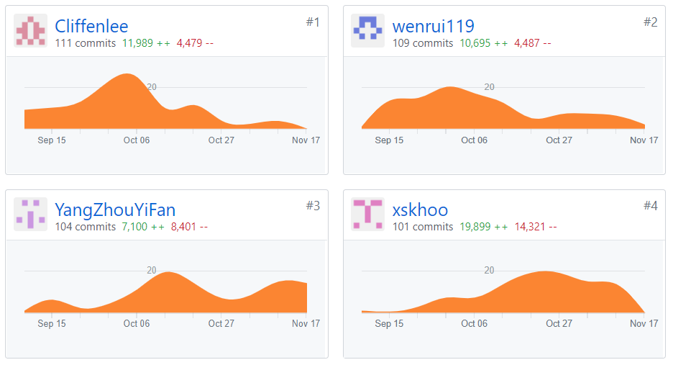

Slide 18
OTHERS

Slide 19



MAIN TAKEAWAYS
COMMUNICATION
PLANNING
REVIEW

Slide 20
ISSUES
Couldn't agree on a common time for PP (End up working late over midnight - inefficiency)
FUN FACT
Cliffen – Was in Project way more than home
Wen Rui – Doesn’t sleep to code
Yi Fan - Loves to drink Fruit Tea and Milo
Xian Shuang - Loves to drink Bubble Tea
Pixelast | Design and Tech

Slide 21
THANK YOU!
ANY QUESTIONS?
G3T7

